Slide 1

Analysis of sales properties and its trends in various parameters.
(Uncovering Patterns to Enhance awareness to Buyer in searching properties)
Buyer in searching properties)
Team member
Goutham
Srikanth
yeshwanth

Slide 2

About me:
I’m Chowke Srikanth has completed B.SC in “Computer science”
Learning data science can lead to diverse career opportunities, offers the chance to solve complex problems, has a significant impact on society and businesses, involves cutting-edge technologies, provides flexibility across industries, and often leads to high demand and competitive salaries.
Linkedin: https://www.linkedin.com/in/srikanth-chowke-0624292a0?utm_source=share&utm_campaign=share_via&utm_content=profile&utm_medium=android_app
Github: https://github.com/srikanthchowke

Slide 3

PROBLEM STATEMENT:
Property buyers face challenges during property searches due to a lack of awareness regarding the availability of properties within their budget, preferred areas, desired sizes, and current land rates. This lack of information hampers their ability to find suitable properties efficiently.
OBJECTIVE:
Our objective is to analyze data within our housing app to provide clients with clear insights into real estate market trends, including:
Understanding the fluctuations in square footage rates across various regions.
Analyzing the trends in the availability of various property Sizes
Identifying the availability of different property types in different addresses.

Slide 4


Slide 5
Key Tasks:
Data collection
Data cleaning
Data Analysis and visualization
Conclusion

Slide 6








Libraries Used:
Requests
BeautifulSoup
Regex(re)
Pandas
Numpy
Matplotlib
Seaborn

Slide 7
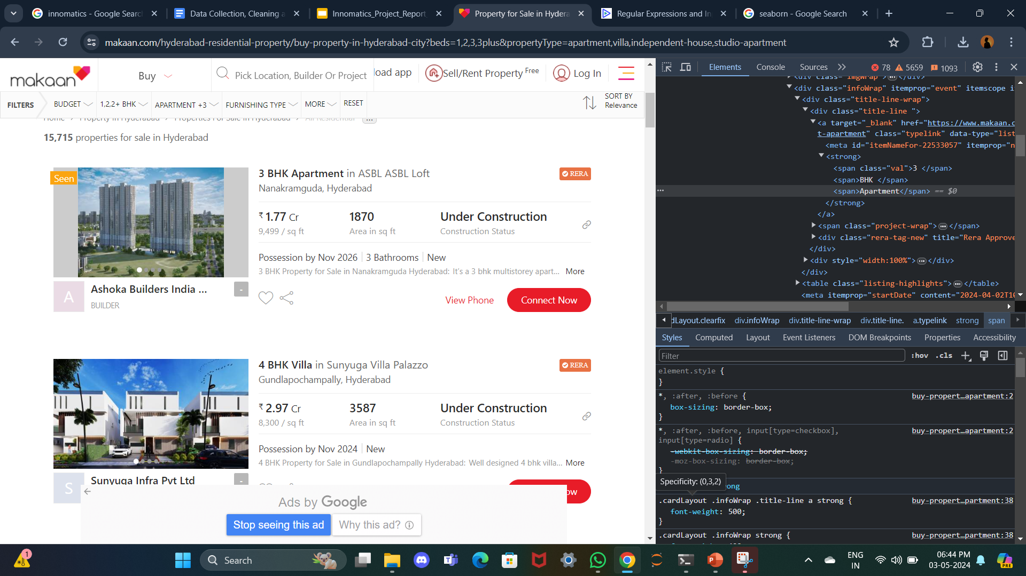
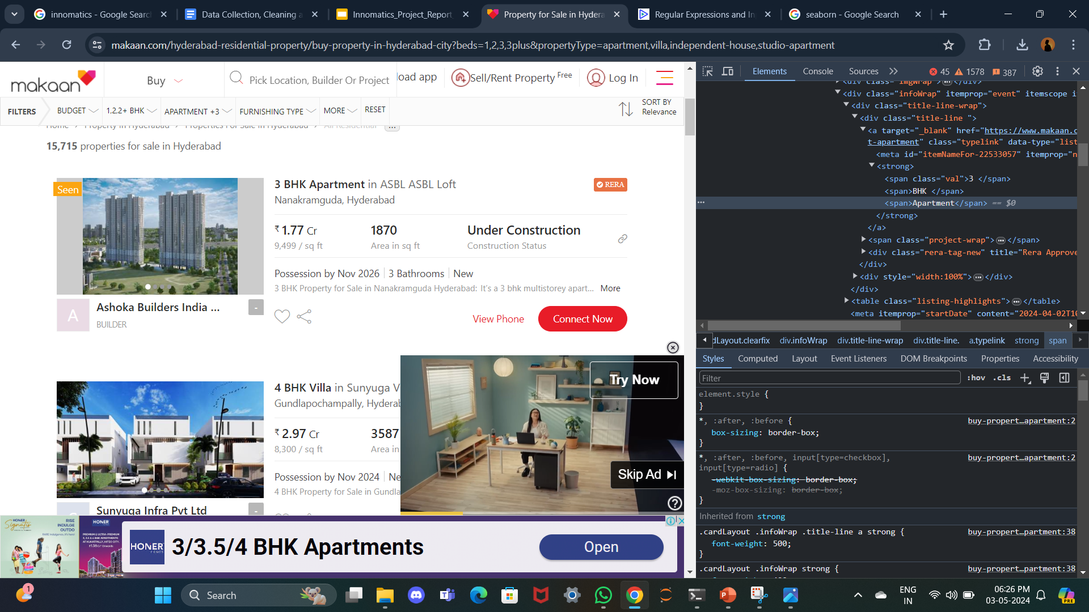
WEB SCRAPING FOR DATA COLLECTION

Slide 8
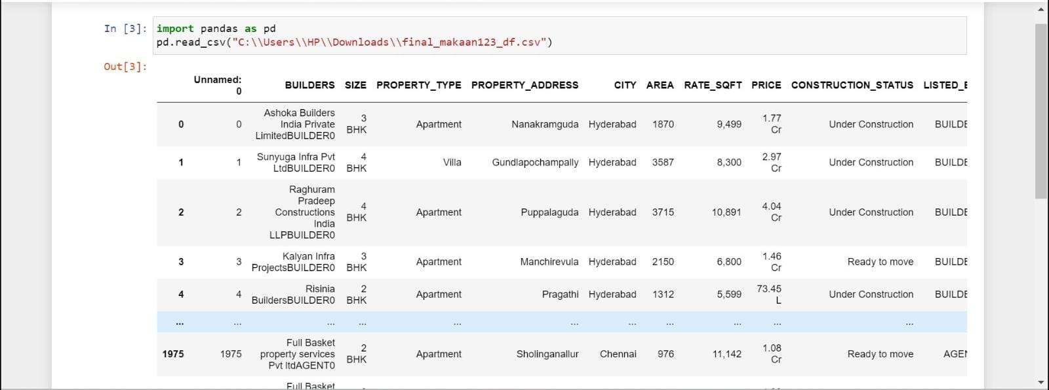
Raw DATA

Slide 9
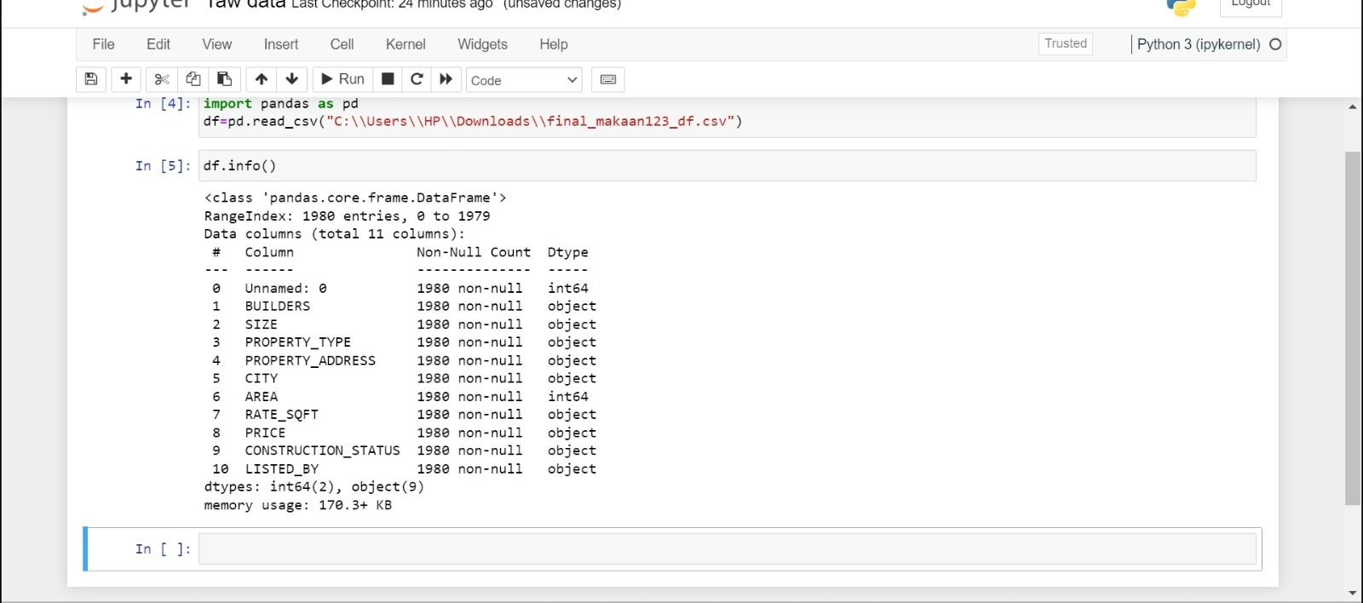
RAW DATA INFO()

Slide 10
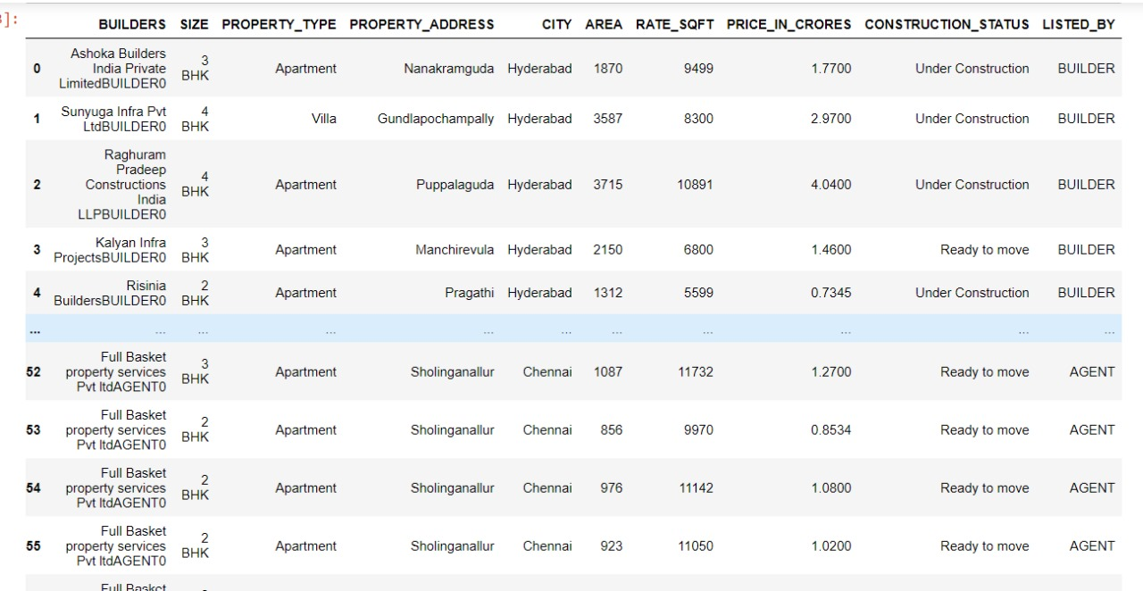
DATA AFTER CLEANING

Slide 11
FUNCTIONS USED IN DATA CLEANING:
is.na()
drop_duplicates()
Replace()
Loc()
Isinstance()
Astype()
Groupby

Slide 12


Slide 13
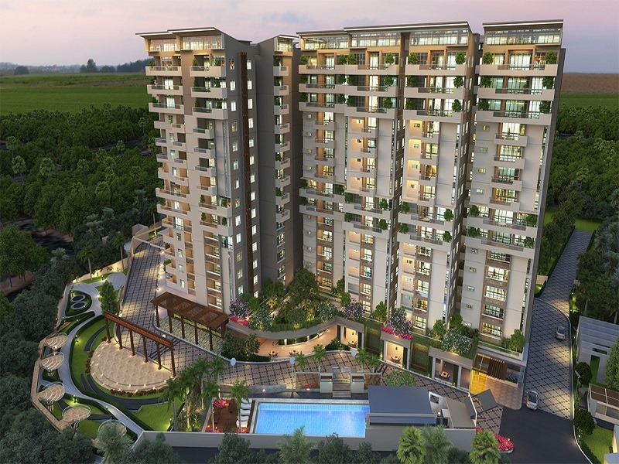
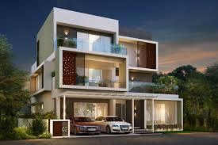


WHAT FACTORS DO YOU CONSIDER WHILE SEARCHING FOR PROPERTY ??

Slide 14
I CONSIDERED THREE PARAMETERS:
RATE PER SQUARE FEET OF AREA
PROPERTY SIZES AVAILABILTY
PROPERTY TYPE AVAILABILTY

Slide 15
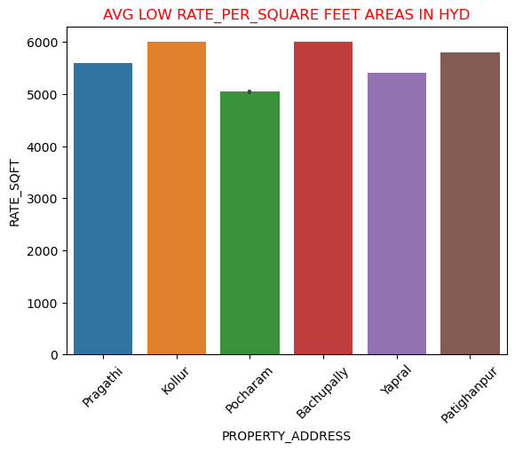
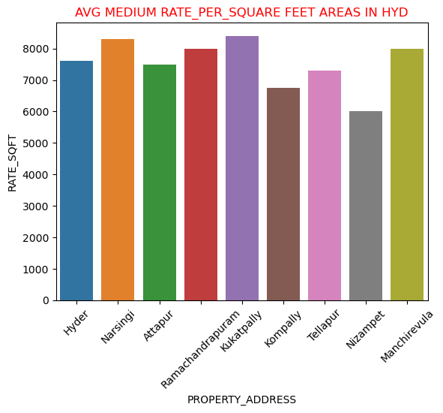
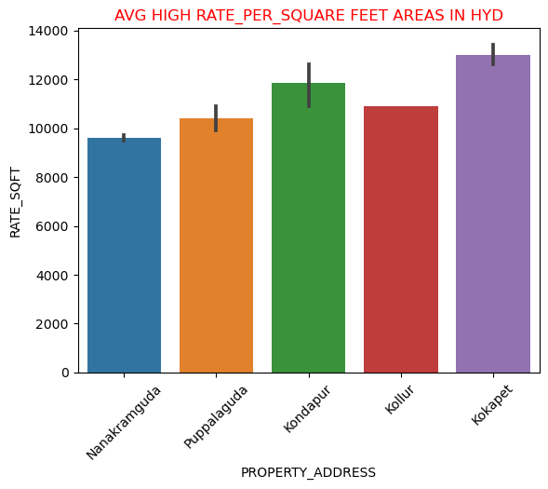
Analysis on Rate per square feet in Hyderabad City based on their Addresses:
In the above bar plots, it illustrates the average low, medium and high Rate per square feet areas within Hyderabad city.
INSIGHTS:
In 1st bar plot ,it is showing Addresses where the (land rate or rate per square feet) is less than (<6000 per square feet).
Similarly, 2nd and 3rd plot showing Addresses where the (land rate or rate per square feet ) is between (6000-9000sqft) And (>9000sqft).
By observing theses plot we able to conclude quick overview of addresses with their Square feet rates this division helps them make informed decisions about where to focus their property

Slide 16
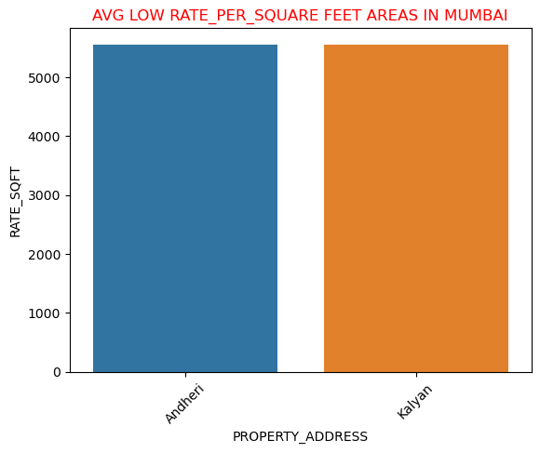
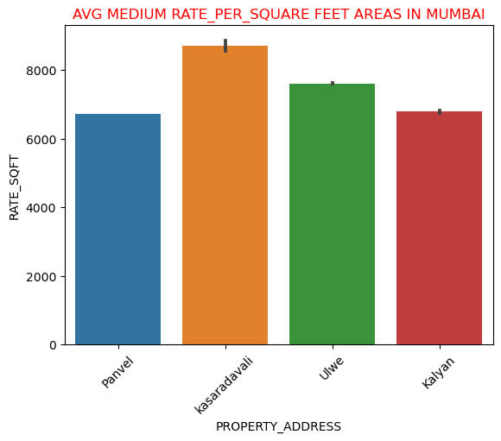
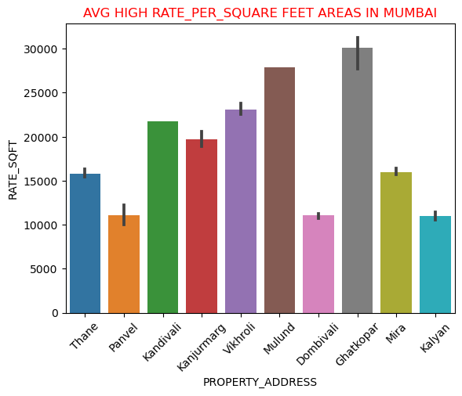
Analysis on Rate per square feet in Mumbai City based on their Addresses:
INSIGHTS:
In 1st bar plot ,it is showing Addresses where the (land rate or rate per square feet) is less than (<6000 per square feet).
Similarly, 2nd and 3rd plot showing Addresses where the (land rate or rate per square feet ) is between (6000-9000sqft) And (>9000sqft).
By observing theses plot we able to conclude quick overview of addresses with their Square feet rates this division helps them make informed decisions about where to focus their property

Slide 17
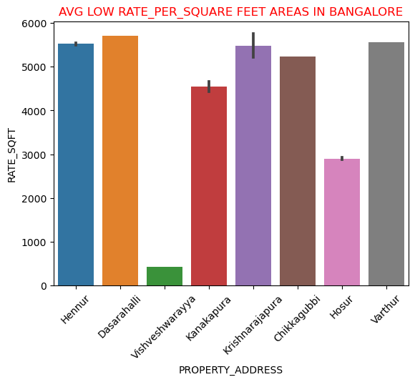
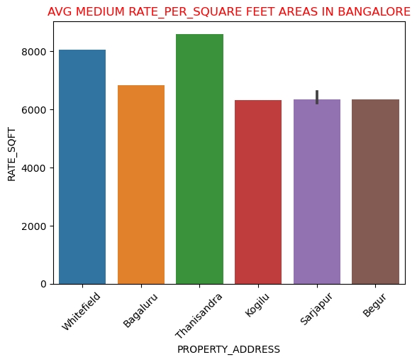
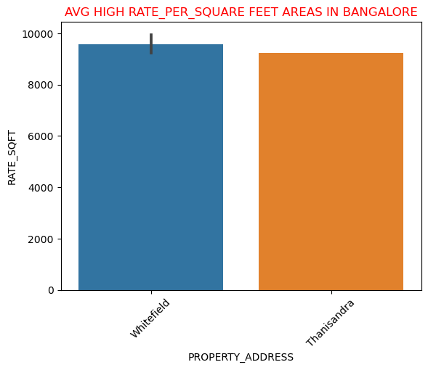
Analysis on Rate per square feet in Bangalore City based on their Addresses:
INSIGHTS:
In 1st bar plot ,it is showing Addresses where the (land rate or rate per square feet) is less than (<6000 per square feet).
Similarly, 2nd and 3rd plot showing Addresses where the (land rate or rate per square feet ) is between (6000-9000sqft) And (>9000sqft).
By observing theses plot we able to conclude quick overview of addresses with their Square feet rates this division helps them make informed decisions about where to focus their property

Slide 18
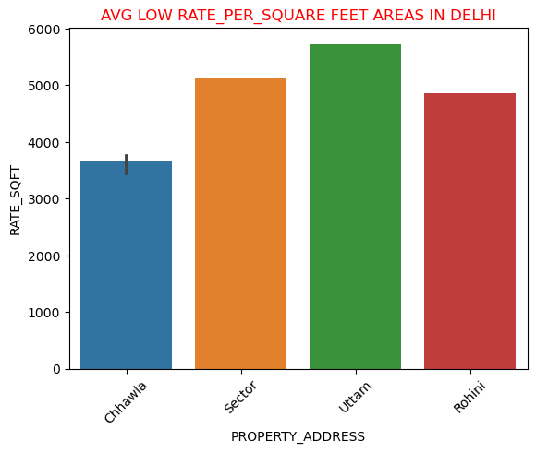
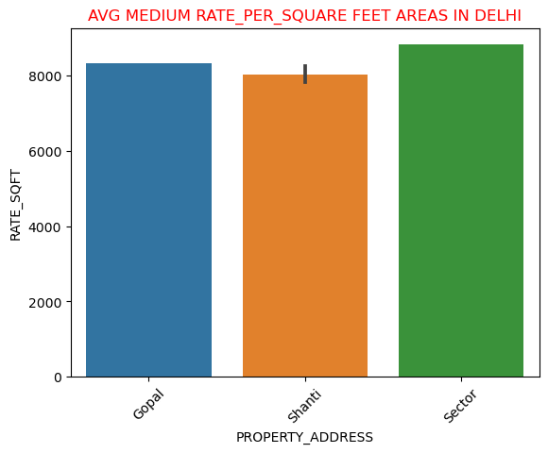
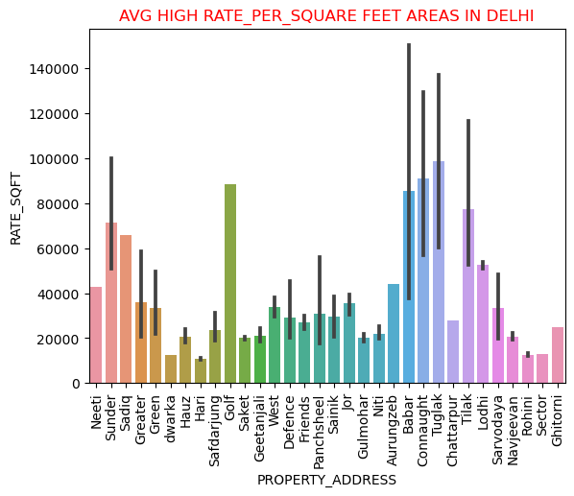
Analysis on Rate per square feet in Delhi City based on their Addresses:
INSIGHTS:
In 1st bar plot ,it is showing Addresses where the (land rate or rate per square feet) is less than (<6000 per square feet).
Similarly, 2nd and 3rd plot showing Addresses where the (land rate or rate per square feet ) is between (6000-9000sqft) And (>9000sqft).
By observing theses plot we able to conclude quick overview of addresses with their Square feet rates this division helps them make informed decisions about where to focus their property

Slide 19
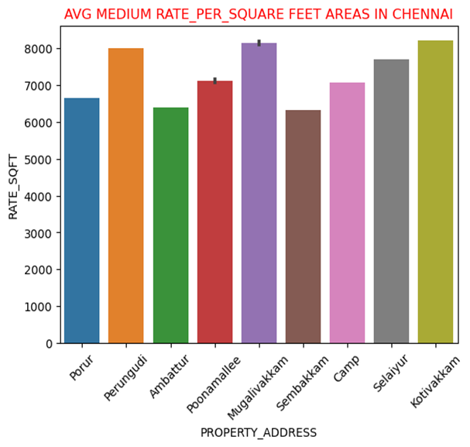
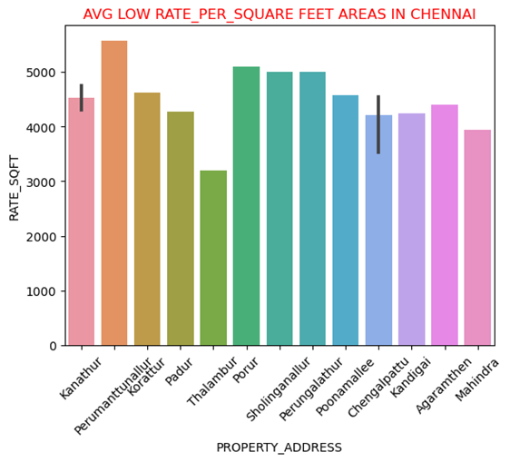
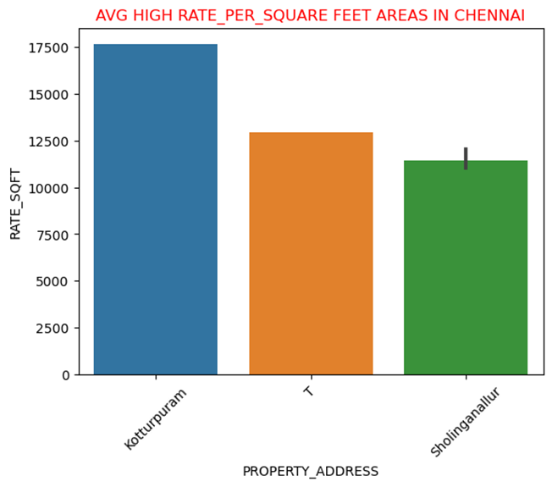
Analysis on Rate per square feet in Chennai City based on their Addresses:
INSIGHTS:
In 1st bar plot ,it is showing Addresses where the (land rate or rate per square feet) is less than (<6000 per square feet).
Similarly, 2nd and 3rd plot showing Addresses where the (land rate or rate per square feet ) is between (6000-9000sqft) And (>9000sqft).
By observing theses plot we able to conclude quick overview of addresses with their Square feet rates this division helps them make informed decisions about where to focus their property

Slide 20
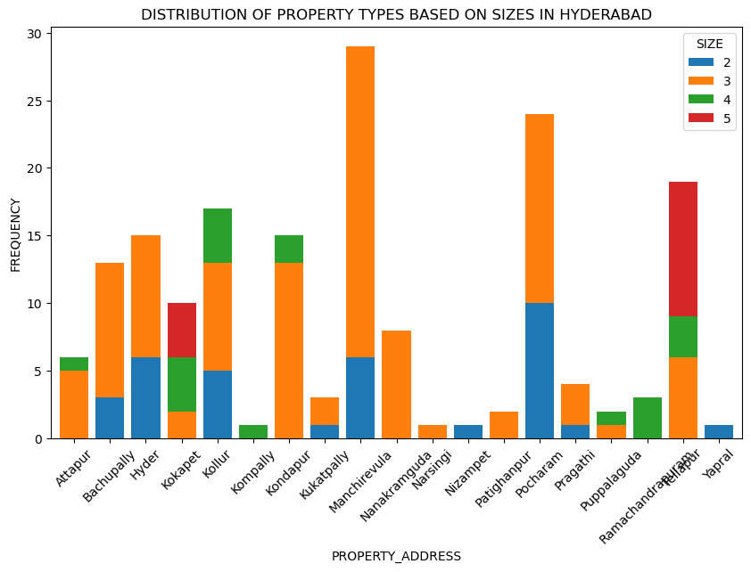
Analysis on distribution of property sizes in Hyderabad City based on their Addresses:
INSIGHTS:
3BHK properties are most common across all areas of Hyderabad.
Significant presence of 3BHK properties in Manchirevula, Pocharam, Kondapur, and Bachupally.
Notable availability of 2BHK properties in Bachupally, Yapral, Pocharam, Hydernagar, and Nizampet.
5BHK properties are significantly found in Kokapet and R.C. Puram

Slide 21
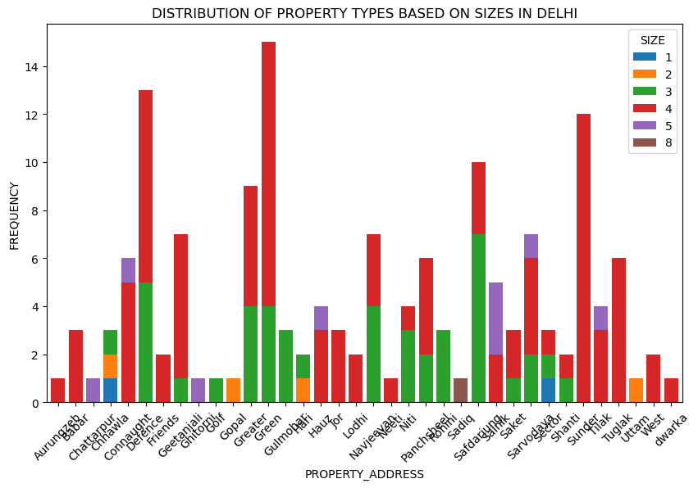
Analysis on distribution of property sizes in Delhi City based on their Addresses:
INSIGHTS:
Based on the provided bar chart, here are four key insights:
1. The chart shows the frequency of different property sizes across various addresses in Delhi, with size 2 properties being the most common across multiple locations.
2. Greater Kailash has the highest number of properties listed, with a particularly high frequency of size 2 properties.
3. Size 8 properties are the least common and are only present in a few locations, such as Aurangzeb Road and Golf Links.
4. Some addresses, like Tilak Marg and Prithviraj Road, have a very low frequency of properties, with only size 2 properties represented.

Slide 22
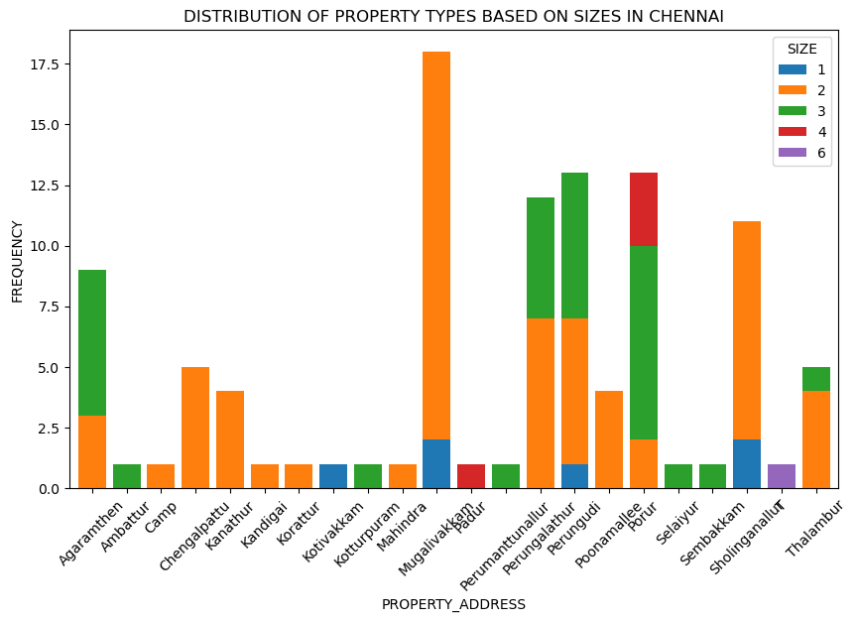
Analysis on distribution of property sizes in Chennai City based on their Addresses:
INSIGHTS:
3BHK properties are most common across all areas of Hyderabad.
Significant presence of 3BHK properties in Manchirevula, Pocharam, Kondapur, and Bachupally.
Notable availability of 2BHK properties in Bachupally, Yapral, Pocharam, Hydernagar, and Nizampet.
5BHK properties are significantly found in Kokapet and R.C. Puram

Slide 23
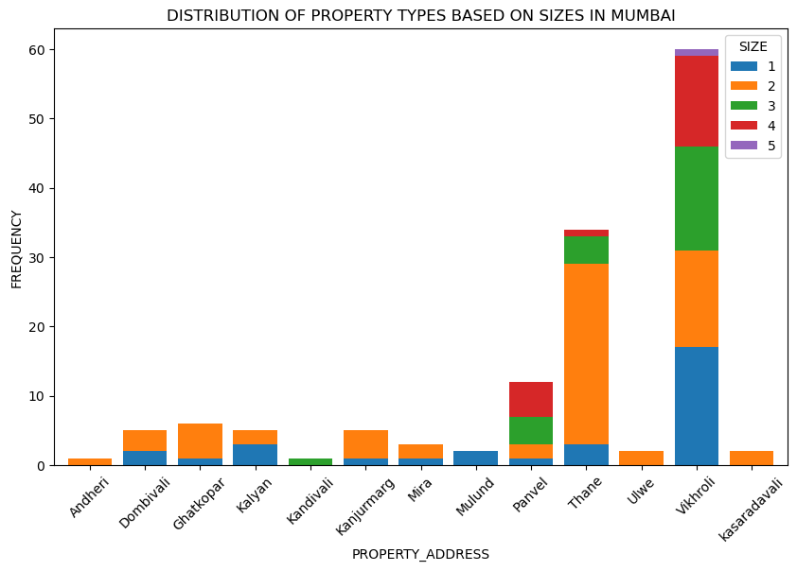
Analysis on distribution of property sizes in Mumbai City based on their Addresses:
INSIGHTS:
Based on the provided bar chart, here are four insights: 1. The chart illustrates the distribution of property types by size in Chennai, with properties of size 2 being the most prevalent across several addresses.
2. Kodambakkam stands out with the highest frequency of properties, particularly those of size 2, followed by size 3 properties.
3. Size 6 properties are the least common and are only found in a few locations, such as T. Nagar and Perungudi. 4. Some addresses like Aminjikarai, Chetpet, and Egmore have a relatively low frequency of properties, with a more even distribution across different sizes.

Slide 24
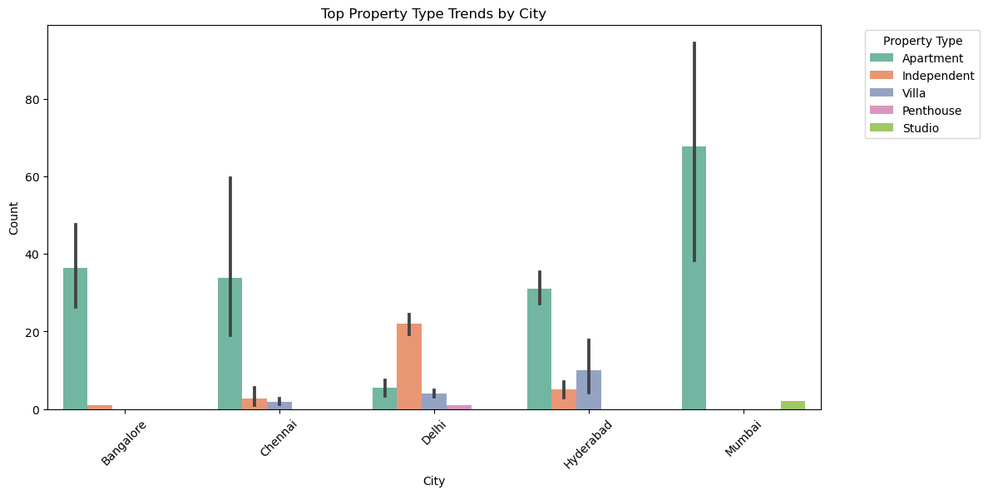
Trends of most common property types in different addresses within city
INSIGHTS:
Based on the provided bar chart, here are four insights:
Apartments are the most common property type across all cities featured in the chart, with Mumbai showing the highest count of apartment properties.
Independent houses are the second most common property type, with Delhi having a notably higher count compared to other cities.
Villas and penthouses have a much lower presence in comparison to apartments and independent houses, with villas being slightly more common than penthouses in the cities shown.
Studio properties have the lowest count and are almost negligible in the data, with only Mumbai showing a small number of studio properties.

Slide 25
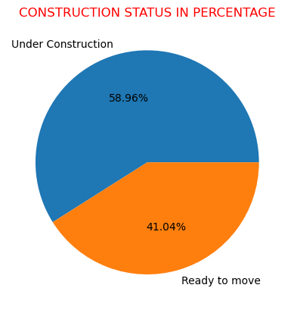
This piechart displays the construction status of overall properties listed in five cities hyderbad,Mumbai,Bangalore,delhi and Chennai.
It conclude 58.96% of properties are into underconstruction status and 41.04% of properties are into ready to move or construction completed

Slide 26
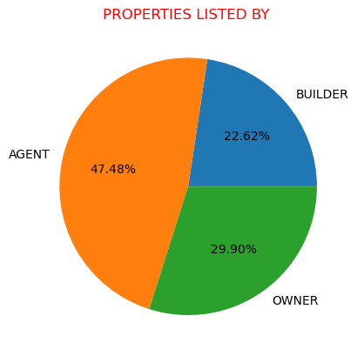
This piechart displays the property listed by status of overall properties in five cities hyderbad,Mumbai,Bangalore,delhi and Chennai.
It conclude 47.48% of properties listed by ‘Agents’
It conclude 22.62%of properties listed by ‘Builders’
It conclude 29.90% of properties listed by ‘Owner’

Slide 27
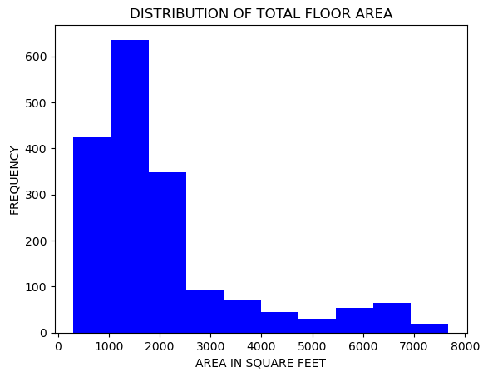
This histogram shows how often different floor area sizes occur. It tells us that the majority of properties in the dataset have floor areas between 500 and 3000 square feet.
it indicates that only fewer properties have total floor areas exceeding 3000 square feet and above

Slide 28
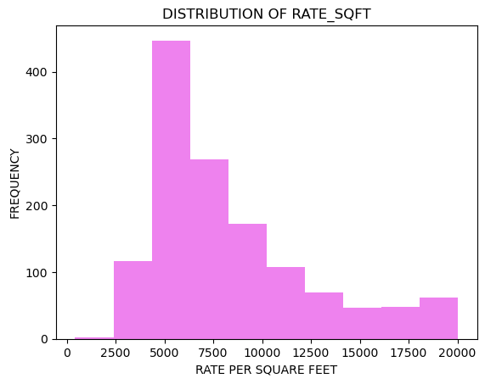
This histogram intrepretes rate per sqft is in between (2500 – 20000) range.
The most frequent Rate per sqft is in between (5000-10000)

Slide 29
CONCLUSION:
Understanding square footage rates, property size trends, and property types in different areas helps investors make smarter real estate decisions, maximizing returns and reducing risks.
Understanding market demand and adapting to preferences helps investors succeed by targeting profitable areas and tailoring their strategies accordingly.

Slide 30
THANK YOU

